Slide 1

W
Predictive Modeling of Wine Quality

Slide 2
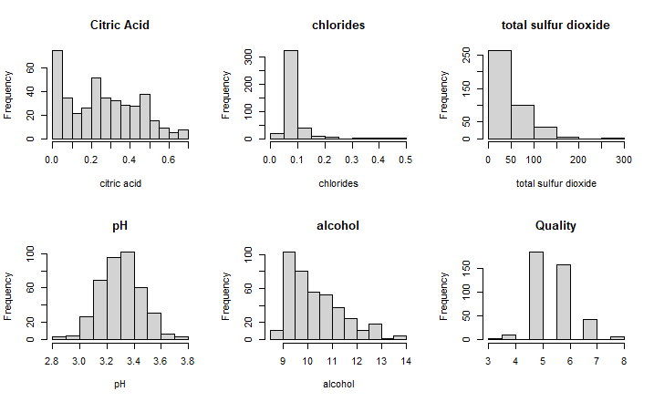

PH – Normally distributed
Data Distributions
Total Sulfur Dioxide – Right Skewed distribution
Chlorides – Heavily Right skewed Distribution

Slide 3
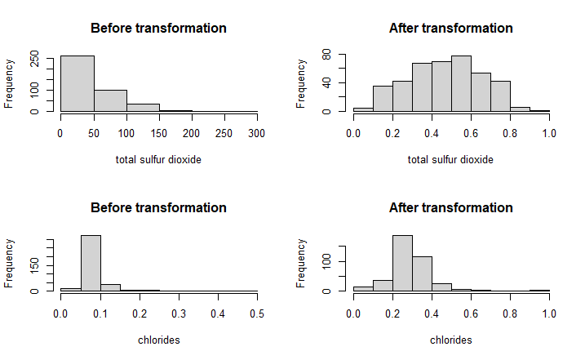
Transformations Applied Here total sulfur dioxide and chlorides had to be transformed logarithmically for better analysis. The rest of the four chosen variables are min-max normalized. p-value = 3.388e-07 p-value = 0.416

Slide 4
Error measures/Correlation coefficients and Weights/Parameters
Ordered Weighted Average
Weights for each variable (QAM)
RMSE | Av. abs error | Pearson correlation | Spearman correlation | Orness
0.188 | 0.1511 | -0.064 | -0.0731 | 0.65
Variable | Weights
Citric Acid | 0.439
Chloride | 0.030
Total Sulfur Dioxide | 0.125
PH | 0.403
Quasi Arithmetic Mean
RMSE | Av. abs error | Pearson correlation | Spearman correlation | Orness
0.176 | 0.143 | 0.136 | 0.128 | -
Weighted Arithmetic Average
RMSE | Av. abs error | Pearson correlation | Spearman correlation | Orness
0.185 | 0.148 | 0.115 | 0.109 | -

Slide 5
Reason for selecting Quasi Arithmetic Mean as my fitting model.
Purpose of aggregating individual variables as the importance of each variable vary greatly and has a significantly different influence on the overall quality of the wine.
The QAM model helps incorporate different weightings for each variable consistently and reliably.
Since most variable have no strictly linear relationship with quality, quasi arithmetic mean would be ideal as it is a better fitting model for more centralized dataset.

Slide 6
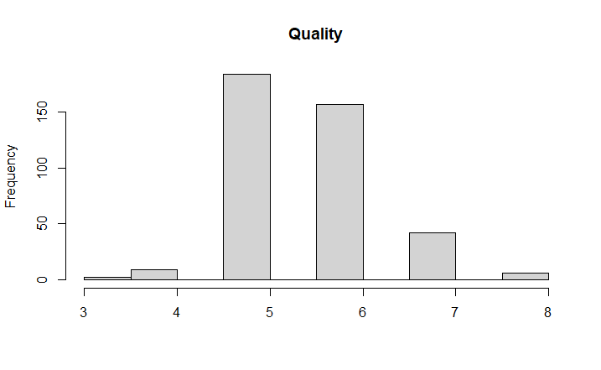
Predicted value for quality for new variable values.
Citric Acid | Chloride | total sulfur dioxide | pH | Alcohol
1 | 0.75 | 40 | 3.53 | 8.3
Predicted Quality value : 6.08
From the frequency of the recorded
quality values, we know average score = 5.615.
Therefore the recorded score is slightly
above average score.

Slide 7
Analysis
From the statistical analysis, we can observe that having the perfect amount of citric acid and PH value matters way more than having the perfect amount of chloride and total sulfur dioxide values.
Having a good citric acid and PH value would result in the wine getting a higher rater than the wine that has good amount of chloride and sulfur dioxide.
Since the variables don’t have a strictly linear relationship with quality, we cannot be certain that an increase or decrease in a certain variable would result in a better quality wine for all cases.
For weighted Arithmetic Mean, for any value of v1,v2,v3,v4 and their corresponding weights w1,w2,w3 and w4 , that satisfies the condition w1v1+w2v2+w3v3+w4v4 = 1 (best value of quality possible to obtain).

